Slide 1
Travel and Daily Allowance Management System
Nikhil Srivastava (B16CS020)
Zaid Khan (B16CS040)

Slide 2
Key Features Of The Software

Slide 3
Enables a new user to register and login to the system.
Felicitates the applying for reimbursement process.
Reimbursement process broken down into two phases :
Before going for the trip.
After returning from the trip.
Admin has the authority to approve or reject a reimbursement notification.
A user can view his own notifications whereas the admin has the power to view all notifications.
To integrate security features, proper security questions have been implemented to avoid breach of privacy

Slide 4
List Of Use Cases

Slide 5
Login
View Details
Register a new user
Forgot Password
Change Password
Authentication
Apply For Reimbursement
Approval From Admin
Notification Updates

Slide 6
Database Structure (Files)

Slide 7
Separate Files have been created for different users, to store their personal details.
Files have been made to store all distinct reimbursement requests.
A Username Database file has been made, to prevent reuse of an already in use username.
Data in the file has been stored in a .csv (similar, because we used `, instead of ,) format, to ease out retrieval and edit routines from files.
File Naming has been done in an easy to retrieve way.

Slide 8
Things we couldn’t implement?

Slide 9
Couldn’t make use of effective and efficient Databases Already existing ( SQLite, MongoDB) .
Currently each student has to apply separately for reimbursement requests. We couldn’t implement a mentor feature, wherein the students could have chosen a mentor, and the mentor would have applied for all such students.
Couldn’t use graphics.h library for effective use on console

Slide 10
Test Plan and Test Analysis

Slide 11
Test Plan:
Unit testing is performed for all modules described above in which the functionalities are not dependent on other modules.
For unit testing all modules described above in scope, Control flow testing and Data flow testing is applied which includes predicate coverage and complete branch coverage.
As all the modules are not independent and they have a shared interface and have a interdependency So attempts are carried out to perform appropriate system integration testing by using bottom up approach. All these are done appropriately to minimize errors.

Slide 12
Unit Testing:
Serial No. | Use Case Tested | Pass/Fail | Issues
1 | RegisterManager: Register | Pass | No Issues
2 | LoginManager: Login | Pass | No Issues
3 | AuthenticationManager: Authentication Details | Pass | No Issues
4 | AuthenticationManager: AuthenticateChangePasswordResponse | Pass | No Issues

Slide 13
Unit Testing:
Serial No. | Use Case Tested | Pass/Fail | Issues
5 | Application: ApplyForReimbursement | Pass | No Issues
6 | Notification: sendNotification | Pass | No Issues
7 | DataBaseAccessLayer: fetchNotification | Pass | No Issues

Slide 14
System Testing:
Serial No. | Use Case Tested | Pass/Fail | Issues
1 | LoginAsUser->ApplyForReimburse-mement | Pass | No Issues
2 | LginAsuser->CheckNotification | Pass | No Issues
3 | LoginAsuser->ApplyForReimbursement (Previous Request) | Pass | No Issues
4 | Register as student | Pass | No Issues
5 | Register as Professor | Pass | No Issues

Slide 15
System Testing:
Serial No. | Use Case Tested | Pass/Fail | Issues
6 | LoginAsAdmin->ShowAllNotificatio-ns | Pass | No Issues
7 | ForgotPassword->LoginAsUser | Pass | No Issues

Slide 16
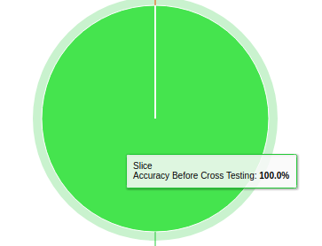
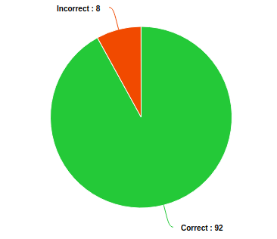
Overall Statistics
Accuracy before cross testing
Accuracy after Cross Testing
Accuracy After Enhancement ( > 99%)

Slide 17
Testing Notes
Unit Testing - CFG Used - Data Flow Testing and Control Flow Testing - Branch Coverage Method
System Testing - Top Down Method and End to End Testing is done.
Cross Project Tetsing - (3 errors found)
During enhancement ( All errors resolved)

Slide 18



Cross Testing Analysis
Attendance Management System
Group -18

Slide 19
List Of Use Cases Tested :
Add Faculty()
Add Student()
Add Attendance()
Modify Attendance()
Login()

Slide 20
List Of Use Cases Tested :
Out of 85 functions, we tested 10-12 use cases, which were enough to test all the use cases.
Out of 12 use cases, 3 bugs were found.
File Handling needs to re-looked into, while modifying user attendance

Slide 21
Conclusions :
Use of DBMS over file handling can make the procedure much more efficient and effective.
Valid changes from cross testing report were implemented in enhancement phase.
C++ application required a lot of time and effort for checking errors during console interactions.
Use of automated tools for testing could have made the testing more robust.

Slide 22


